Slide 1
PHONENOW CALL CENTRE

Slide 2
PhoneNow Call Center Report
Overview
This report provides an analysis of the PhoneNow Call Center’s performance metrics. The report covers the following aspects:
Total calls received and answered.
Number of agents and topics.
Call status and resolution.
Agents’ performance in terms of call duration, satisfaction rating, and speed of answer.
The report also offers some recommendations for improving the call center’s efficiency and customer satisfaction.

Slide 3
Key Findings
The call center received 5,000 calls and had 8 agents available.
The call center answered 89% of the calls, but only resolved 28% of them.
The average satisfaction rating was 3 out of 6, which is low and indicates dissatisfaction among the callers.
The average speed of answer was 55 seconds, which is above the industry standard of 28 seconds.
The agents had varying performance in terms of call duration, resolution, and satisfaction rating. Jim had the longest call duration (666 seconds) and the lowest satisfaction rating (1). Joe had the highest resolution rate (100%) and the second-lowest satisfaction rating (2). Becky and Ben had the highest satisfaction ratings (4), but did not resolve any calls.

Slide 4
Recommendations
Based on these findings, some possible recommendations for improving the call center’s performance are:
Increase the number of agents to handle the high volume of calls and reduce the waiting time for the callers.
Provide more training and feedback to the agents on how to resolve the callers’ issues effectively and efficiently.
Monitor and reward the agents’ performance based on the resolution rate and the satisfaction rating, not just the call duration.
Identify and address the common topics and issues that the callers have, and provide the agents with the relevant information and resources to handle them.

Slide 5
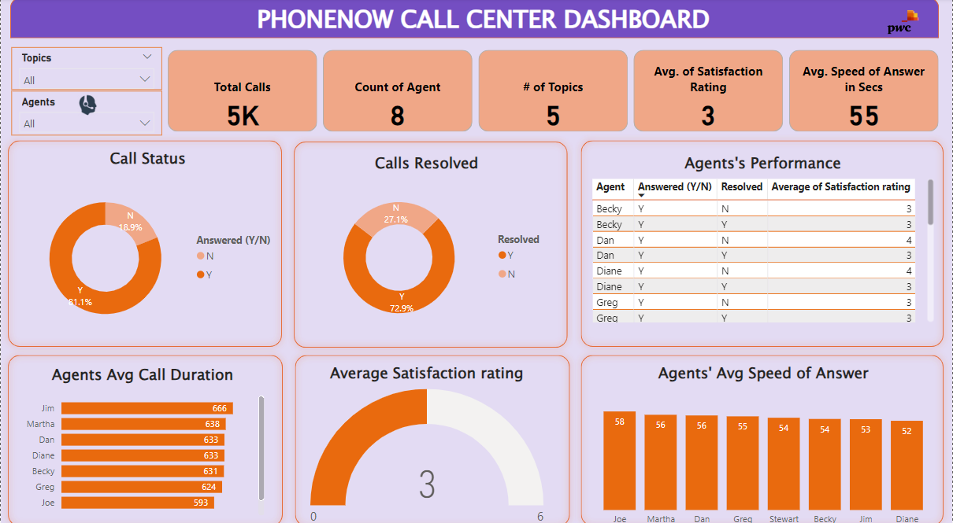

Slide 6
Conclusion
The PhoneNow Call Center Dashboard provides a comprehensive overview of the call center’s performance metrics. It indicates that there are some areas of improvement, such as the resolution rate, the satisfaction rating, and the speed of answer. By implementing the recommendations suggested in this report, the call center can enhance its efficiency and customer satisfaction.

